Slide 1
Data mining for LTE Test Effectiveness
February 18, 2016

Slide 2


WHO
University of Concordia – Montreal
Dr. Peter C Rigby, Dr. Emad Shihab, Dr. Ian Shang
Examples of previous studies :
Studying big log data analysis with Google Page-Rank, Hadoop and Blackberry log data
Studying code review at Microsoft
Studying code quality and code risk at BlackBerry
Test creation prioritization at BlackBerry
Measuring test effectiveness on Google Chrome
Quantifying developer turnover risk at Avaya
Microsoft-Research contact : Kim Herzig
“The art of testing less without sacrificing quality”
Dr. Rigby arranged for Herzig to present to E/// CIRV
Microsoft cannot run all tests on all code commits.
Identify tests that are more likely to find defects (Effective)
Golden rule: all tests will eventually be run
Gary Mckenna – TM – LTE/5G
Students (current : Maaz Rehman
and Anunay Amar)
Pragash K – CIRV QA STAB
Roy R – CIRV QA Func
Chris G – Line
University
300 KSEK Canadian Government Research Funding
1 added student free for a year
Opportunity for higher level of funding in 2016
UNIVERSITY COLLABORATION

Slide 3
WHY
Testing Effectiveness : Product Integration - LTE
Increase effectiveness of tests and faster verdicts / faster feedback
Reduce waste of developers time on analyzing false alarms - Productivity
Identify troublesome SW product units (SWUs) – improve SW quality
Determine the risk of making a software change.

Slide 4
WHAT
GOALS
Identify tests more likely to find defects (Effective)
Prioritize analysis of test verdicts – filter out the noise
Address tests that cause false test alarms (Reliability)
Help PDs identify risky deliveries for extended testing
MEASURES TO DATE :
How often does a test fail without a TR? (False Alarm) – TC effectiveness
Identify anomaly in test verdict to filter noise – highlight product failures
Number of TRs per SWU?
How likely is a commit to introduce a bug?
ALL TESTS WILL EVENTUALLY BE RUN

Slide 5
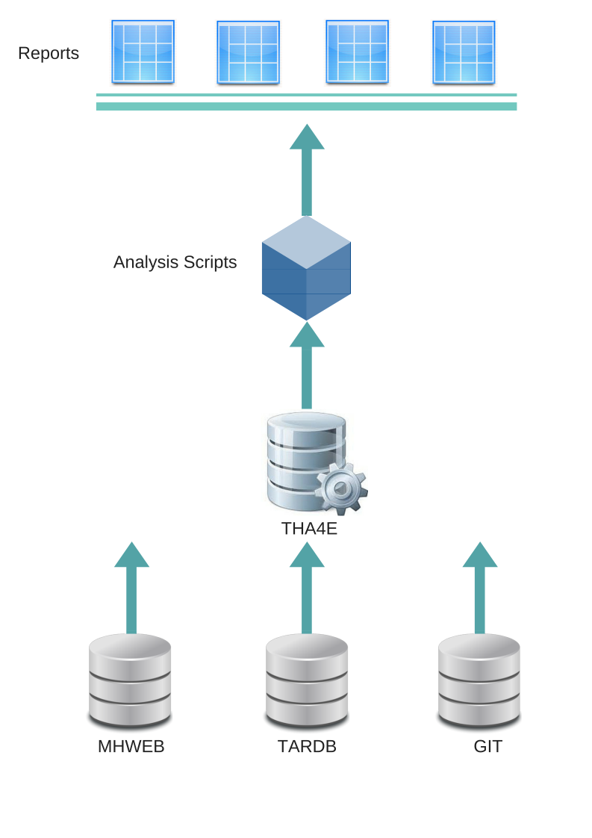
HOW
Mine data from MHWEB, TARDB, Git …
Clean / and link data
Run analyzes, such as
Test redundancy
Failure distribution
Produce reports
Effective and reliable tests
How many TRs created as a result of a test failure? (Good alarms)
How often does a test fail without a TR? (False Alarm)
Identify anomalous test verdicts
How many TRs per SWU?
Notes:
Microsoft has 13 researchers who work on understanding the data that Engineers produce in their work and helping them work more productively. 5 of which work on Tools for SE.
http://research.microsoft.com/en-us/groups/ese/default.aspx

Slide 6
WHERE
STABILITY
Date: June 2014 to June 2015
Scope: All global runs
Measure:
Effectiveness
Troublesome SWU
FUNCTIONALITY
Date: January 2014 to January 2016
Scope: Ottawa and Linköping
Measure:
Anomaly in verdict
Troublesome SWU

Slide 7
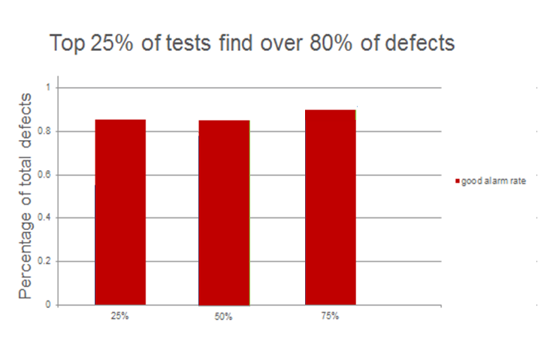
STAB: Effectiveness pilot
Conclusion: Product issue impacts a limited number of KPIs
Notes:
-Product only impacts a fixed number of KPIs
-Simulated random 1000 times (ie pick 25 percent of tests and see what percent of defects)
-good alarm, order by tests that in the past have found the most defects
-false alarm, order by tests that have the least number of fails that didn’t lead to defects

Slide 8
STAB: Troublesome Units
Software Unit | TRs
lratG1LmC | 39
uehUeComSigHandlerSwU | 23
uehNwIfTapDispatcherSwU | 22
uehRrcSigCtxtSwU | 10
omfPmBbAdaptorSwU | 9
upcUlCellCeSwU | 6
upUlL1PeMctSwU | 6
upUlL1PePucchCoordSwU | 5
TOP 8
Notes:
Yuecai:
Total number of TRs
Time period: 1 year 2014-06-07 to 2015-06-06
Total number of TRs
ifu swu, lu

Slide 9
QA Func
Test analysis problems
Not enough time to analyze all test failures
Lots of noise, tests fail for non product issues
Some product issues take days to identify
Goal : Which failures to deep dive into?
Find failures with High probability to be product related
Over a 2 year period
Test runs: 6 million
Test passes: 95%
Test failures: 4.9% (305,156)
Number of TRs on failures: < 0.39% (1216)
Benefits :
Focus on the right thing FIRST.
Faster feedback to the design teams.
Less chance of a faults slipping into more expensive test loops.

Slide 10


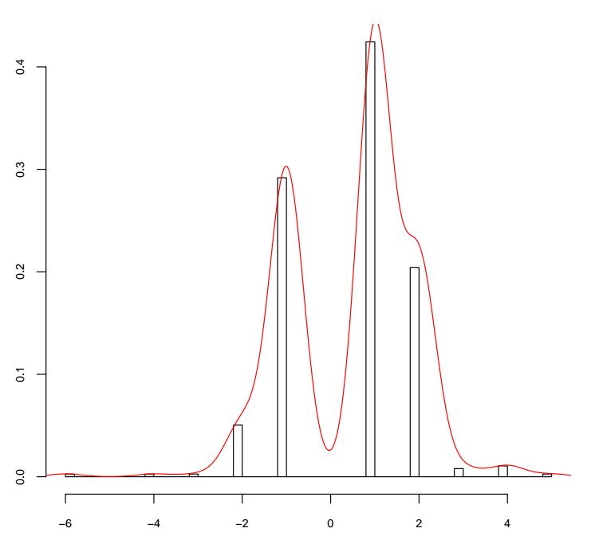
Statistical approach
Historical Information
Past Test Result Trends
Past Test Log Patterns
Past SWU to TC Failure correlation
Prioritized TC failures
Current Information
UP Test Results
UP Test Logs
UP SWu deliveries
Percentage of test runs
3 or more fails in a day is an anomaly

Slide 11
FUNC: Top Anomalies – prioritize daily analysis
Normal Fails (Product related failures)
Anomalous Fails (false alarms – environment failures)
Percentage of test runs

Slide 12
PROGRESS and next steps
QA STAB :
Pilot : Identify troublesome SWUs ✓
QA Func :
Prioritize test analysis based on
TEST RESULT TRENDS ✓
DAILY REPORTS OF ANOMALOUS TESTS ARE USED BY TEST TEAM TO PRIORITIZE WORK ✓
COMMIT RISK ANALYSIS (commit.guru)
TEST LOGS AND ERROR SIGNATURES
SWU TO TEST FAILURES CORRELATION
Going forward :
Followup on STAB findings
Evaluation of techniques for Func.
Scheduled reports and on-demand
Big log pattern analysis for anomalies
Apply to other QAs
Visualization
Identification of risky updates
Automating test prioritization
Fault Slip-through analysis
More research funding

